Slide 1
Weekly report: Rotor Blade Design
Week number: 05
Date: 28/10/2025
Supervisor:Prof. Dr. rer.nat. Alois Schaffarczyk
Presented by: Harsh Panchal / Jay Pandya, Kandarp Pathak, Daniyal Sikander
28.10.2025
1
Daniyal Sikandar
Rotor Blade Design/ Optimus Syria

Slide 2
List of contents
Analysis of Thickness Distribution vs Chord length for NREL 5 MW and Optimus Shakti
Blade geometry with python code
Graphs of C_{L},C_{D} and Angle of attack
28.10.2025
Daniyal Sikandar
Rotor Blade Design / Optimus Syria

Slide 3
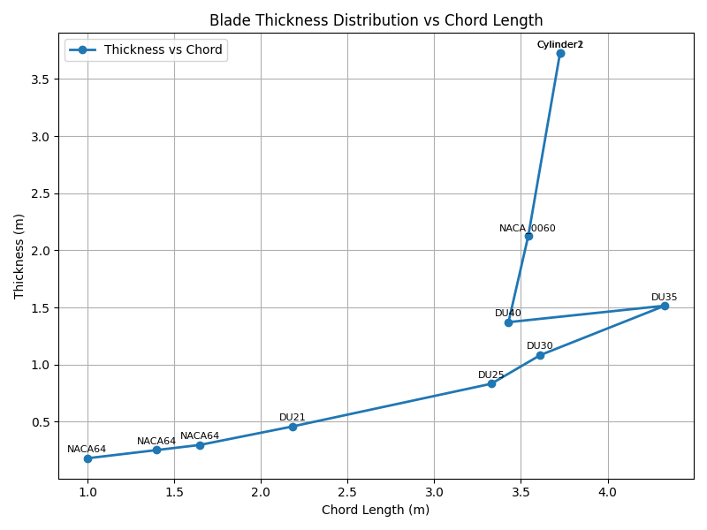
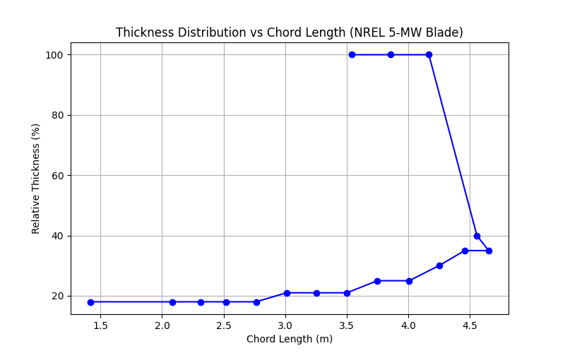
Thickness Distribution vs Chord length
Source: Own Analysis Visual Studio Code
28.10.2025
Daniyal Sikandar
Rotor Blade Design / Optimus Syria

Slide 4
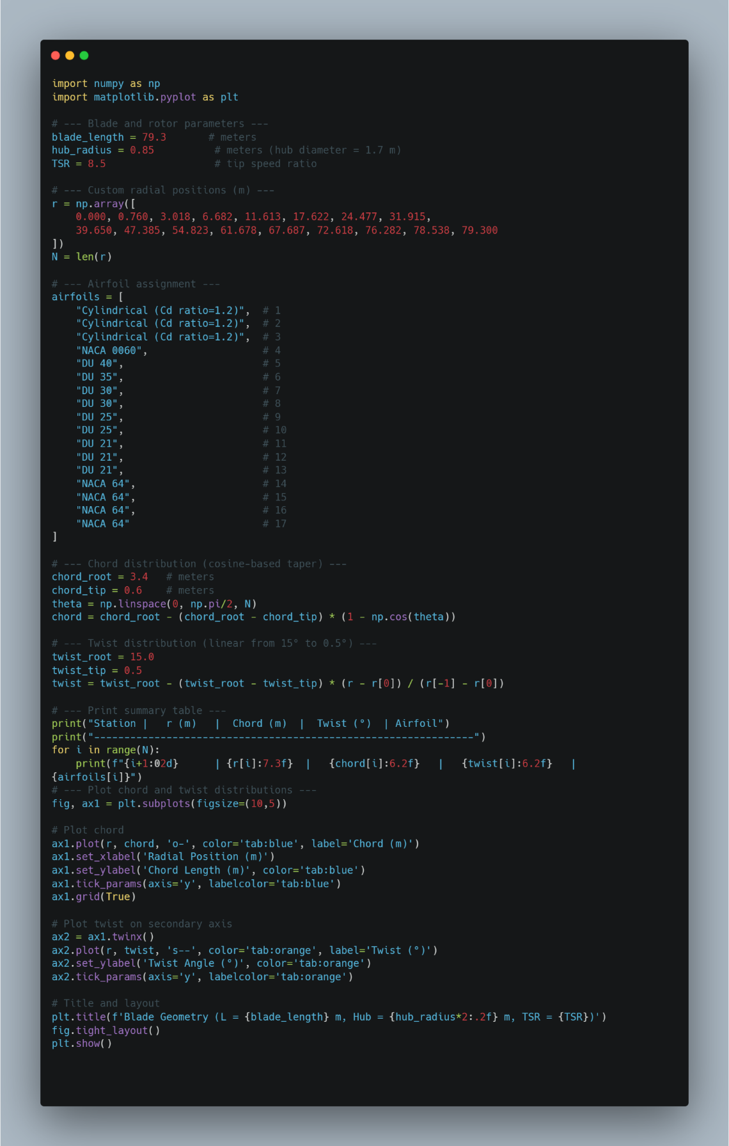
Blade Geometry With Python Code
With the help of this code we have defined chord distribution and twist angle of each blade section.
Source: Own Analysis Visual Studio Code
28.10.2025
Daniyal Sikandar
Rotor Blade Design / Optimus Syria

Slide 5
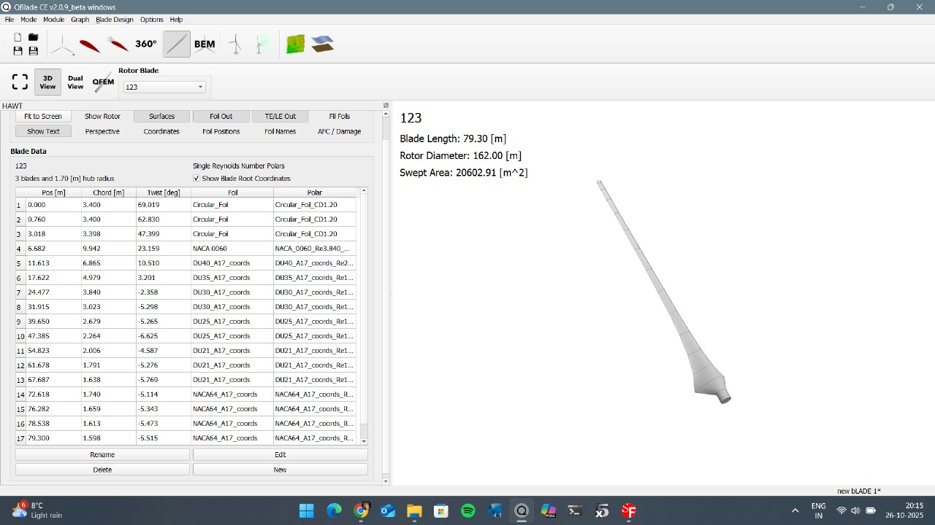
Blade Geometry
Source: Own Analysis Q Blade
28.10.2025
Daniyal Sikandar
Rotor Blade Design / Optimus Syria

Slide 6
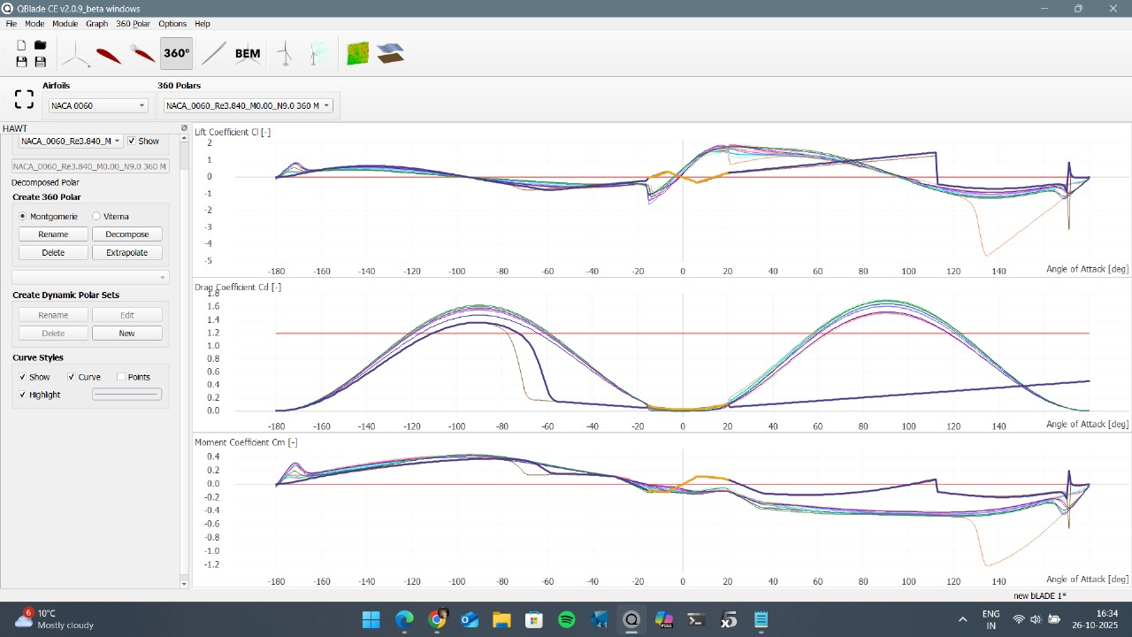
Graphs of C_{L},C_{D} & Angle of Attack
Source: Own Analysis Q Blade
28.10.2025
Daniyal Sikandar
Rotor Blade Design / Optimus Syria

Slide 7
Bibliography
Self Generated Content (24.10.2025)(18:29)
28.10.2025
Daniyal Sikandar
Rotor Blade Design / Optimus Syria

